Slide 1
Student Employee Survey - 2018
Facilitated by S.T.A.G

Slide 2
Background Information
In order to assess overall student employee engagement and satisfaction the Student Training Advisory Group (S.T.A.G.) administered our third annual Student Employee Survey
We finally have some multi-year comparisons
Survey Monkey (open from 4/5/18 to 4/24/18)
55 of the ~157 students responded, ~35% (down from 40% in 2017)
Unfortunately, some departments had few respondents
Notes:
Consider respondent distribution by AUL when interpreting results; demographic data is a limited representation of employee composition
Change in questions: Time commitment section is new; Q11 & Q12 have been split apart (formally one question); Q13 was formally a ranking question; Q14 is new; Q15 statement 3 – ‘bored’ replaced with ‘disinterested’; Q16 the second to last statement was altered to say ‘…effectively communicated essential policies/procedures to me.” instead of ‘…was an effective use of my time.’

Slide 3
2018 Respondent Dist. vs Actual Dist. (by AUL)

Slide 4
2018 Response Rate Per AUL

Slide 5
Respondents’ AUL Distribution: Cross-Year Comparison

Slide 6
Respondents’ Demographic Data: Ethnicity (optional)

Slide 7
Respondents’ Demographic Data: Gender Identity (optional)

Slide 8
Respondents’ Demographic Data: Sexual Orientation (optional)

Slide 9
Respondents’ Demographic Data: Academic Status

Slide 10
Respondents’ Demographic Data: Length of Employment

Slide 11
Time Commitments
Q7: Do you have other large time commitments outside of classes and working at the Library?
Q8:

Slide 12
Q9: Time Commitments – Ranking Averages
Strongly Disagree
Strongly Agree

Slide 13
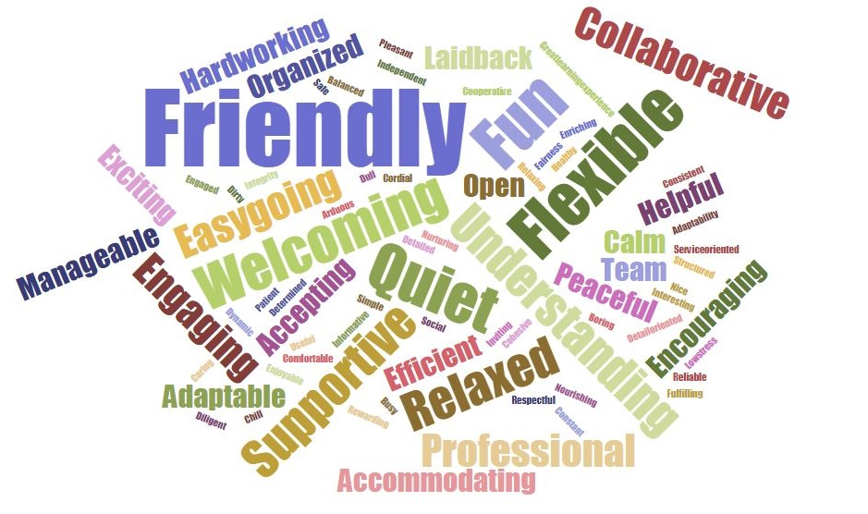
Q10: What three words would you use to describe the UCSB Library’s work culture?

Slide 14
Q11: Please list one thing you enjoy the most and one thing you enjoy the least about working at the UCSB Library?
Q12: What is one thing you would change about working at the UCSB Library? (Optional)
See handout for full list
Highlights:
Most: Flexibility; the people (co-workers, supervisors, patrons); assignments and interactions with the collections
Least: Communication breakdowns; hour limitations (max and department operating hours); rude patrons
Contradictions: Hours of operation; physical environment; short shifts
See handout for full list
Highlights: a want for more cross-departmental interactions; repeal of the hour limitation policy; lack of perks
36% of respondents wrote ‘Nothing’

Slide 15
Q13: When seeking clarification on a UCSB Library employee policy, which do you prefer to reference first?

Slide 16
Q14: Communication & Training Initiatives

Slide 17
Q15: Employee Engagement - Ranking Averages
Strongly Disagree
Strongly Agree

Slide 18
Q16: Onboarding and Performance Evaluations - Ranking Averages
Strongly Disagree
Strongly Agree

Slide 19
Q17: Do you have any other comments?
“Nope, but thank you for all you do for us employees!!”
“Mallory Gianola is the best supervisor ever and she has really helped me grow from just being a student to [a] responsible working employee. I really enjoy working with her and will miss working here after I graduate.”
“I love libraries, so I’m biased, but this is definitely the best job I’ve ever had :’)”
“My supervisor, Katy, is great.”
“I would recommend that we find a way to get other UCSB students interested in voting to make a $1 or two of their tuition to go towards the library. I think this is not too much to ask from each student because it is unfair that qualified individuals who would like the opportunity to work at the library cannot because we generally don’t look further at their application because they do not have work study.”
“I really love working at the library”

Slide 20
What is the feedback telling us?
2017
2018
63% of respondents are new employees and did not participate in the previous survey
Continued perception of a ‘Friendly’ space and work-culture
Some student employees are feeling isolated
Students care about the state of their physical work environment - they are keenly aware of the spaces around them
Students want to be engaged and meet other employees
Students want to develop professionally
The building project completion is no longer a main source of frustration
~41% of respondents are new employees; strong retention between 2017 new hires into the 2018 AY
Q15 data demonstrates a high level of student employee engagement
Q16 data points to effective utilization of tools developed in-house
We need to find more effective means of communicating with our student employees
More than half of our respondents have large time commitments outside of classes and their shifts at the UCSB Library – a large proportion have other jobs (paid/unpaid)
We are an employer who actively supports academic success for our student assistants
Should we continue our 19.5 hr/wk policy?

Slide 21
Questions?

